Slide 1
Project Sales Analysis
Best-Selling Products
Peak Sales periods
High-Value Customer Segments (Region)
High-Value Customer Segments (Gender)
High-Value Customer Segments (Age)

Slide 2
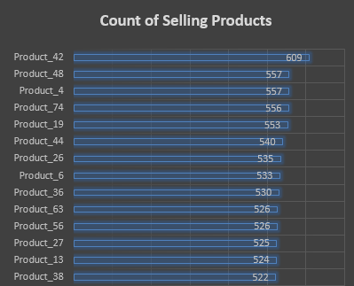
Best-Selling Products
Recommendations:
Those products more promoting which leads more sales.

Slide 3
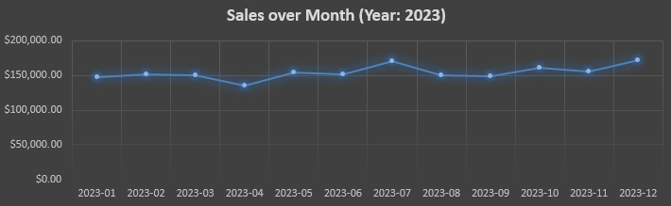
Peak Sales periods
As above, months July, October, and December are peak periods.
Recommendations:
Scale Marketing Efforts.
Increase Inventory if needed.

Slide 4
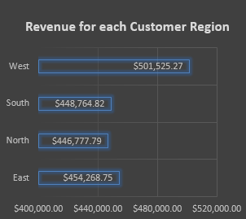
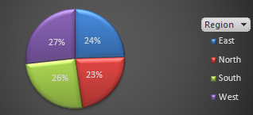
High-Value Customer Segments (Region)
As above, Customers at West region are high-value.
This is because the percentage of customers from the West is greater than other regions, and it is also possible that their purchases are greater than other customers because the difference in revenues is very large compared to the difference in customer counts.

Slide 5
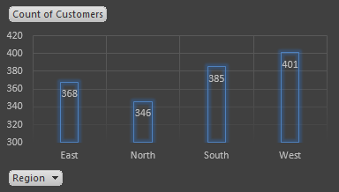
High-Value Customer Segments (Region)
Recommendation:
Focus on West region (high-performing region) in marketing and presenting more products and categories.
East also needs customers increasing for more revenue.

Slide 6
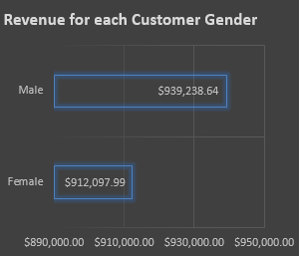
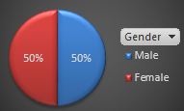
High-Value Customer Segments (Gender)
As above, male customers are high-value despite equal male and female contribution to purchases.
Recommendation:
Focus on males customers in marketing and presenting more products and categories.

Slide 7
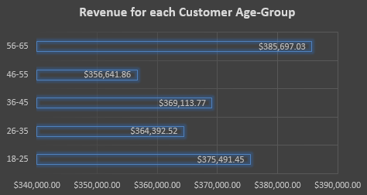
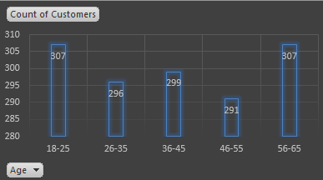
High-Value Customer Segments (Age)
As above, although 18-25 and 56-65 segments have the same number of customers and are the highest in count, the 56-65 segment has the high-value.
Recommendation:
Focus on 56-65 & 18-25 age-group in marketing and presenting more products and categories.

